Slide 1
Open-Economy Macroeconomics:
Basic Concepts
© 2015 Cengage Learning. All Rights Reserved. May not be copied, scanned, or duplicated, in whole or in part, except for use as permitted in a license distributed with a certain product or service or otherwise on a password-protected website for classroom use.

Slide 2
Basic Concepts
Closed economy
  Economy that does not interact with other economies in the world
Open economy
  Economy that interacts freely with other economies around the world
© 2015 Cengage Learning. All Rights Reserved. May not be copied, scanned, or duplicated, in whole or in part, except for use as permitted in a license distributed with a certain product or service or otherwise on a password-protected website for classroom use.

Slide 3
Open Economy
Interacts with other economies:
  It buys and sells goods and services in world product markets
  It buys and sells capital assets such as stocks and bonds in world financial markets
© 2015 Cengage Learning. All Rights Reserved. May not be copied, scanned, or duplicated, in whole or in part, except for use as permitted in a license distributed with a certain product or service or otherwise on a password-protected website for classroom use.

Slide 4
The Flow of Goods
Exports
  Goods and services that are produced domestically and sold abroad
Imports
  Goods and services that are produced abroad and sold domestically
Net exports (Trade balance)
  Value of a nation’s exports minus the value of its imports
© 2015 Cengage Learning. All Rights Reserved. May not be copied, scanned, or duplicated, in whole or in part, except for use as permitted in a license distributed with a certain product or service or otherwise on a password-protected website for classroom use.

Slide 5
The Flow of Goods
Trade balance (Net exports)
  Value of a nation’s exports minus the value of its imports
Trade surplus (Positive net exports)
  Exports are greater than imports
    The country sells more goods and services abroad than it buys from other countries
© 2015 Cengage Learning. All Rights Reserved. May not be copied, scanned, or duplicated, in whole or in part, except for use as permitted in a license distributed with a certain product or service or otherwise on a password-protected website for classroom use.

Slide 6
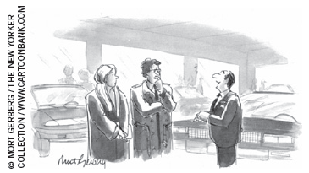
The Flow of Goods
Trade deficit (Negative net exports)
  Imports are greater than exports
    The country sells fewer goods and services abroad than it buys from other countries
Balanced trade
  Exports equal imports
“But we’re not just talking about buying a car—we’re talking about confronting this country’s trade deficit with Japan.”
© 2015 Cengage Learning. All Rights Reserved. May not be copied, scanned, or duplicated, in whole or in part, except for use as permitted in a license distributed with a certain product or service or otherwise on a password-protected website for classroom use.

Slide 7
The Flow of Goods
Factors that might influence a country’s exports, imports, and net exports:
  Tastes of consumers for domestic and foreign goods
  Prices of goods at home and abroad
  Exchange rates at which people can use domestic currency to buy foreign currencies
© 2015 Cengage Learning. All Rights Reserved. May not be copied, scanned, or duplicated, in whole or in part, except for use as permitted in a license distributed with a certain product or service or otherwise on a password-protected website for classroom use.

Slide 8
The Flow of Goods
Factors that might influence a country’s exports, imports, and net exports:
  Incomes of consumers at home and abroad
  Cost of transporting goods from country to country
  Government policies toward international trade
© 2015 Cengage Learning. All Rights Reserved. May not be copied, scanned, or duplicated, in whole or in part, except for use as permitted in a license distributed with a certain product or service or otherwise on a password-protected website for classroom use.

Slide 9
The increasing openness of the U.S. economy
Increasing importance of international trade and finance
  1950s, imports and exports: 4-5% of GDP
  Recent years – about three times that level
Largest trading partner, 2012 (imports and exports combined)
  Canada
  Followed by China, Mexico, Japan, Germany, and the United Kingdom
© 2015 Cengage Learning. All Rights Reserved. May not be copied, scanned, or duplicated, in whole or in part, except for use as permitted in a license distributed with a certain product or service or otherwise on a password-protected website for classroom use.

Slide 10
The increasing openness of the U.S. economy
Increase in international trade
  Improvements in transportation
    Cargo ships, long-distance jets, wide-body jet
  Advances in telecommunications
    Telephone, e-mail
  Technological progress
    Light and easy to transport goods
  Government’s trade policies
    NAFTA, GATT
© 2015 Cengage Learning. All Rights Reserved. May not be copied, scanned, or duplicated, in whole or in part, except for use as permitted in a license distributed with a certain product or service or otherwise on a password-protected website for classroom use.

Slide 11
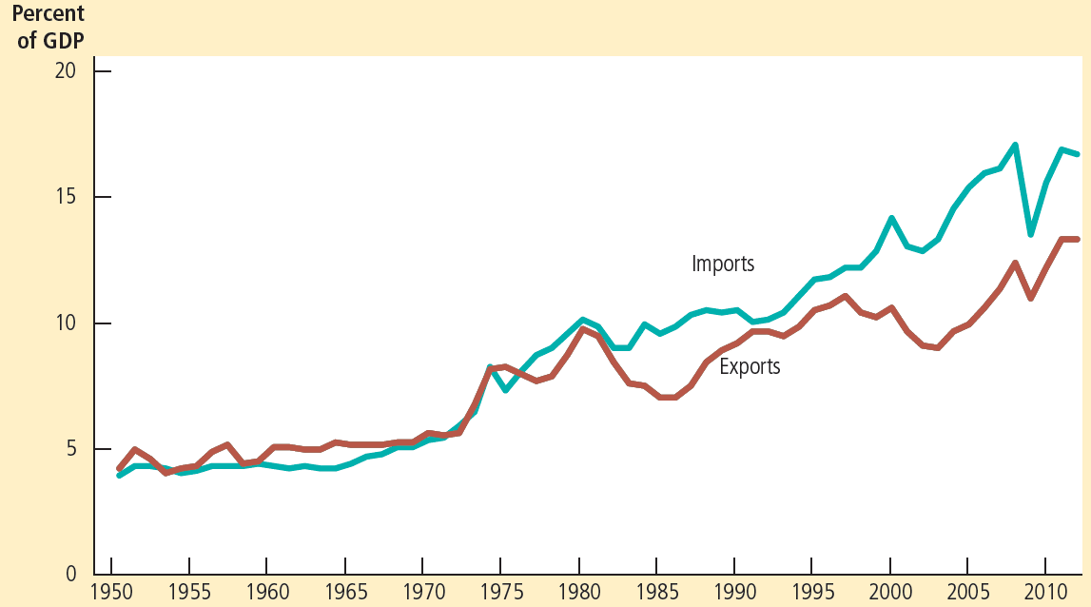
Figure 1
The Internationalization of the U.S. Economy
This figure shows exports and imports of the U.S. economy as a percentage of U.S. GDP since 1950. The substantial increases over time show the increasing importance of international trade and finance.
© 2015 Cengage Learning. All Rights Reserved. May not be copied, scanned, or duplicated, in whole or in part, except for use as permitted in a license distributed with a certain product or service or otherwise on a password-protected website for classroom use.

Slide 12
The Flow of Financial Resources
Net capital outflow
  Purchase of foreign assets by domestic residents
    Foreign direct investment
    Foreign portfolio investment
  Minus the purchase of domestic assets by foreigners
© 2015 Cengage Learning. All Rights Reserved. May not be copied, scanned, or duplicated, in whole or in part, except for use as permitted in a license distributed with a certain product or service or otherwise on a password-protected website for classroom use.

Slide 13
The Flow of Financial Resources
Variables that influence net capital outflow
  Real interest rates paid on foreign assets
  Real interest rates paid on domestic assets
  Perceived economic and political risks of holding assets abroad
  Government policies that affect foreign ownership of domestic assets
© 2015 Cengage Learning. All Rights Reserved. May not be copied, scanned, or duplicated, in whole or in part, except for use as permitted in a license distributed with a certain product or service or otherwise on a password-protected website for classroom use.

Slide 14
Net Exports=Net Capital Outflow
Net exports (NX)
  Imbalance between a country’s exports and its imports
Net capital outflow (NCO)
  Imbalance between
    Amount of foreign assets bought by domestic residents
    And the amount of domestic assets bought by foreigners
Identity: NCO = NX
© 2015 Cengage Learning. All Rights Reserved. May not be copied, scanned, or duplicated, in whole or in part, except for use as permitted in a license distributed with a certain product or service or otherwise on a password-protected website for classroom use.

Slide 15
Net Exports=Net Capital Outflow
When NX > 0 (trade surplus)
  Selling more goods and services to foreigners
    Than it is buying from them
  From net sale of goods and services
    Receives foreign currency
    Buy foreign assets
    Capital is flowing out of the country: NCO > 0
© 2015 Cengage Learning. All Rights Reserved. May not be copied, scanned, or duplicated, in whole or in part, except for use as permitted in a license distributed with a certain product or service or otherwise on a password-protected website for classroom use.

Slide 16
Net Exports=Net Capital Outflow
When NX < 0 (trade deficit)
  Buying more goods and services from foreigners
    Than it is selling to them
  The net purchase of goods and services
    Needs financed
    Selling assets abroad
    Capital is flowing into the country: NCO < 0
© 2015 Cengage Learning. All Rights Reserved. May not be copied, scanned, or duplicated, in whole or in part, except for use as permitted in a license distributed with a certain product or service or otherwise on a password-protected website for classroom use.

Slide 17
Saving and Investment
Open economy: Y = C + I + G + NX
National saving: S = Y – C – G
  Y – C – G = I + NX
  S = I + NX
NX = NCO
  S = I + NCO
  Saving = Domestic investment + Net capital outflow
© 2015 Cengage Learning. All Rights Reserved. May not be copied, scanned, or duplicated, in whole or in part, except for use as permitted in a license distributed with a certain product or service or otherwise on a password-protected website for classroom use.

Slide 18
International Flows
Trade surplus: Exports > Imports
  Net exports > 0
  Y > Domestic spending (C+I+G)
  S > I
  NCO > 0
© 2015 Cengage Learning. All Rights Reserved. May not be copied, scanned, or duplicated, in whole or in part, except for use as permitted in a license distributed with a certain product or service or otherwise on a password-protected website for classroom use.

Slide 19
International Flows
Trade deficit: Exports < Imports
  Net exports < 0
  Y < Domestic spending (C+I+G)
  S < I
  NCO < 0
© 2015 Cengage Learning. All Rights Reserved. May not be copied, scanned, or duplicated, in whole or in part, except for use as permitted in a license distributed with a certain product or service or otherwise on a password-protected website for classroom use.

Slide 20
International Flows
Balanced trade : Exports = Imports
  Net exports = 0
  Y = Domestic spending (C+I+G)
  S = I
  NCO = 0
© 2015 Cengage Learning. All Rights Reserved. May not be copied, scanned, or duplicated, in whole or in part, except for use as permitted in a license distributed with a certain product or service or otherwise on a password-protected website for classroom use.

Slide 21
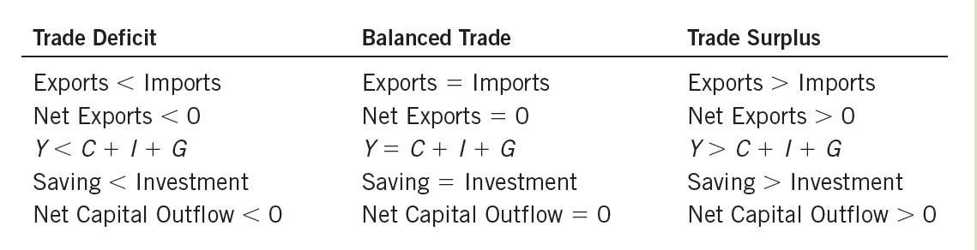
Table 1
International Flows of Goods and Capital: Summary
This table shows the three possible outcomes for an open economy.
© 2015 Cengage Learning. All Rights Reserved. May not be copied, scanned, or duplicated, in whole or in part, except for use as permitted in a license distributed with a certain product or service or otherwise on a password-protected website for classroom use.

Slide 22
Is the U.S. trade deficit a national problem?
The United States
  “The world’s largest debtor”
  Borrowing heavily in world financial markets during the past three decades
    To finance large trade deficits
Before 1980
  National saving and domestic investment were close
  Small net capital outflow (between – 1 and 1 % of GDP)
© 2015 Cengage Learning. All Rights Reserved. May not be copied, scanned, or duplicated, in whole or in part, except for use as permitted in a license distributed with a certain product or service or otherwise on a password-protected website for classroom use.

Slide 23
Is the U.S. trade deficit a national problem?
After 1980
  National saving – often falling below domestic investment
  Sizable trade deficits
  Substantial inflows of capital
  Net capital outflow is often a large negative number
© 2015 Cengage Learning. All Rights Reserved. May not be copied, scanned, or duplicated, in whole or in part, except for use as permitted in a license distributed with a certain product or service or otherwise on a password-protected website for classroom use.

Slide 24
Is the U.S. trade deficit a national problem?
Unbalanced fiscal policy: 1980 to 1987
  Flow of capital into the U.S. declines
    From 0.5 to 3.1% of GDP (2.6 percentage point change)
  Due to a fall in national saving of 3.2 percentage points
    Due to decline in public saving
    Increase in the government budget deficit
    President Ronald Reagan cut taxes and increased defense spending
© 2015 Cengage Learning. All Rights Reserved. May not be copied, scanned, or duplicated, in whole or in part, except for use as permitted in a license distributed with a certain product or service or otherwise on a password-protected website for classroom use.

Slide 25
Is the U.S. trade deficit a national problem?
An investment boom: 1991 to 2000
  Increase flow of capital (from 0.5 to 3.9% of GDP)
  Saving increased
  Government budget surplus
  Investment increased from 13.4 to 17.8% of GDP
© 2015 Cengage Learning. All Rights Reserved. May not be copied, scanned, or duplicated, in whole or in part, except for use as permitted in a license distributed with a certain product or service or otherwise on a password-protected website for classroom use.

Slide 26
Is the U.S. trade deficit a national problem?
An economic downturn: 2000 to 2012
  Large capital flow into the U.S.
  Investment fell 4.5 percentage points
    Tough economic times starting in 2008 made additional capital less profitable
  National saving fell 4.5 percentage points
    Extraordinarily large budget deficits in response to the downturn
© 2015 Cengage Learning. All Rights Reserved. May not be copied, scanned, or duplicated, in whole or in part, except for use as permitted in a license distributed with a certain product or service or otherwise on a password-protected website for classroom use.

Slide 27
Is the U.S. trade deficit a national problem?
At the end of the economic downturn
  National saving was financing only about two-thirds of domestic investment
  Flows of capital from abroad financed the rest
Are these trade deficits and international capital flows a problem for the U.S. economy?
  No easy answer to this question
© 2015 Cengage Learning. All Rights Reserved. May not be copied, scanned, or duplicated, in whole or in part, except for use as permitted in a license distributed with a certain product or service or otherwise on a password-protected website for classroom use.

Slide 28
Is the U.S. trade deficit a national problem?
Trade deficit induced by a fall in saving (1980s)
  The nation is putting away less of its income to provide for its future
  No reason to deplore the resulting trade deficits
    Better to have foreigners invest in the U.S. economy than no one at all
© 2015 Cengage Learning. All Rights Reserved. May not be copied, scanned, or duplicated, in whole or in part, except for use as permitted in a license distributed with a certain product or service or otherwise on a password-protected website for classroom use.

Slide 29
Is the U.S. trade deficit a national problem?
Trade deficit induced by an investment boom (1990s)
  Economy is borrowing from abroad to finance the purchase of new capital goods
    For good return on investment - the economy should be able to handle the debts that are being accumulated
    For lower return on investment - debts will look less desirable
© 2015 Cengage Learning. All Rights Reserved. May not be copied, scanned, or duplicated, in whole or in part, except for use as permitted in a license distributed with a certain product or service or otherwise on a password-protected website for classroom use.

Slide 30
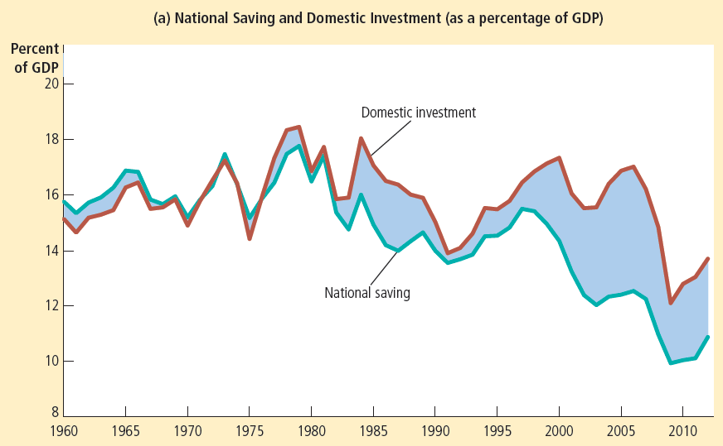
Figure 2
National Saving, Domestic Investment, and Net Capital Outflow
Panel (a) shows national saving and domestic investment as a percentage of GDP. You can see from the figure that national saving has been lower since 1980 than it was before 1980. This fall in national saving has been reflected primarily in reduced net capital outflow rather than in reduced domestic investment.
© 2015 Cengage Learning. All Rights Reserved. May not be copied, scanned, or duplicated, in whole or in part, except for use as permitted in a license distributed with a certain product or service or otherwise on a password-protected website for classroom use.

Slide 31
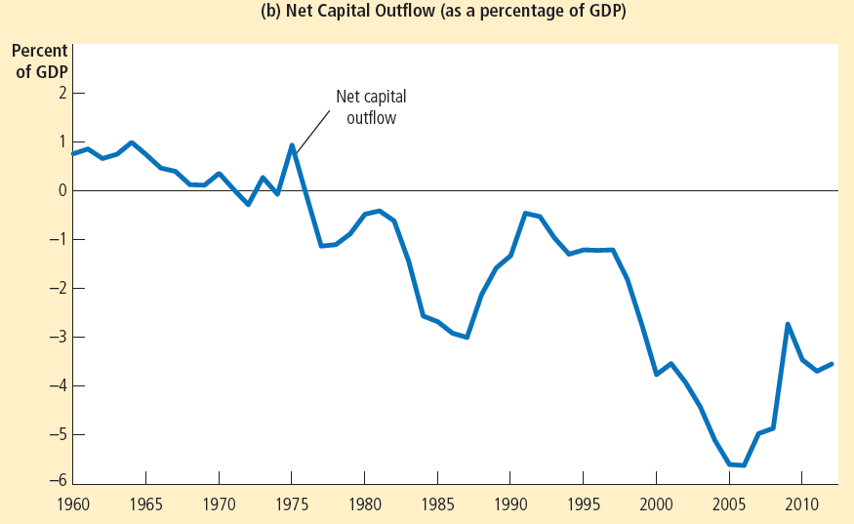
Figure 2
National Saving, Domestic Investment, and Net Capital Outflow
Panel (b) shows net capital outflow as a percentage of GDP. You can see from the figure that national saving has been lower since 1980 than it was before 1980. This fall in national saving has been reflected primarily in reduced net capital outflow rather than in reduced domestic investment.
© 2015 Cengage Learning. All Rights Reserved. May not be copied, scanned, or duplicated, in whole or in part, except for use as permitted in a license distributed with a certain product or service or otherwise on a password-protected website for classroom use.

Slide 32
Prices for International Transactions
Nominal exchange rate
  Rate at which a person can trade currency of one country for currency of another
Example
  Exchange rate = 80 yen per dollar
© 2015 Cengage Learning. All Rights Reserved. May not be copied, scanned, or duplicated, in whole or in part, except for use as permitted in a license distributed with a certain product or service or otherwise on a password-protected website for classroom use.

Slide 33
Prices for International Transactions
Appreciation (strengthen)
  Increase in the value of a currency as measured by the amount of foreign currency it can buy
    Buy more foreign currency
Example: dollar appreciation
  Exchange rate (old) = 80 yen per dollar
  Exchange rate (new) = 90 yen per dollar
  (Yen depreciation)
© 2015 Cengage Learning. All Rights Reserved. May not be copied, scanned, or duplicated, in whole or in part, except for use as permitted in a license distributed with a certain product or service or otherwise on a password-protected website for classroom use.

Slide 34
Prices for International Transactions
Depreciation (weaken)
  Decrease in the value of a currency
  As measured by the amount of foreign currency it can buy
    Buy less foreign currency
Example: dollar depreciation
  Exchange rate (old) = 80 yen per dollar
  Exchange rate (new) = 70 yen per dollar
  (Yen appreciation)
© 2015 Cengage Learning. All Rights Reserved. May not be copied, scanned, or duplicated, in whole or in part, except for use as permitted in a license distributed with a certain product or service or otherwise on a password-protected website for classroom use.

Slide 35
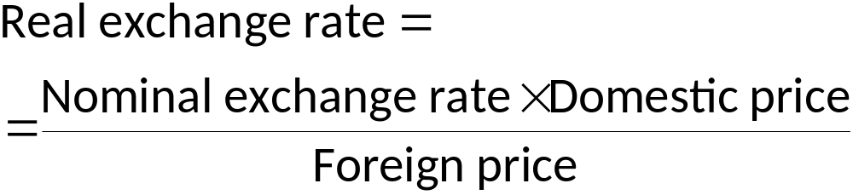
Prices for International Transactions
Real exchange rate
  Rate at which a person can trade goods and services of one country
  For goods and services of another
© 2015 Cengage Learning. All Rights Reserved. May not be copied, scanned, or duplicated, in whole or in part, except for use as permitted in a license distributed with a certain product or service or otherwise on a password-protected website for classroom use.

Slide 36
Prices for International Transactions
Real exchange rate = (e ˣ P) / P*
  Using price indexes
  e: nominal exchange rate between the U.S. dollar and foreign currencies
  P: price index for U.S. basket
  P*: price index for foreign basket
© 2015 Cengage Learning. All Rights Reserved. May not be copied, scanned, or duplicated, in whole or in part, except for use as permitted in a license distributed with a certain product or service or otherwise on a password-protected website for classroom use.

Slide 37
Prices for International Transactions
Depreciation (fall) in the U.S. real exchange rate
  U.S. goods: cheaper relative to foreign goods
  Consumers at home and abroad buy more U.S. goods and fewer goods from other countries
    Higher exports
    Lower imports
    Higher net exports
© 2015 Cengage Learning. All Rights Reserved. May not be copied, scanned, or duplicated, in whole or in part, except for use as permitted in a license distributed with a certain product or service or otherwise on a password-protected website for classroom use.

Slide 38
Prices for International Transactions
An appreciation (rise) in the U.S. real exchange rate
  U.S. goods - more expensive compared to foreign goods
  Consumers at home and abroad - buy fewer U.S. goods and more goods from other countries
    Lower exports
    Higher imports
    Lower net exports
© 2015 Cengage Learning. All Rights Reserved. May not be copied, scanned, or duplicated, in whole or in part, except for use as permitted in a license distributed with a certain product or service or otherwise on a password-protected website for classroom use.

Slide 39
Purchasing-Power Parity
Purchasing-power parity, PPP
  Theory of exchange rates
  A unit of any given currency should be able to buy the same quantity of goods in all countries
Basic logic of purchasing-power parity
  Based on the law of one price
  A good must sell for the same price in all locations
© 2015 Cengage Learning. All Rights Reserved. May not be copied, scanned, or duplicated, in whole or in part, except for use as permitted in a license distributed with a certain product or service or otherwise on a password-protected website for classroom use.

Slide 40
Purchasing-Power Parity
Arbitrage
  Take advantage of price differences for the same item in different markets
  Result: the law of one price
PPP
  Parity: Equality
  Purchasing-power: Value of money in terms of quantity of goods it can buy
© 2015 Cengage Learning. All Rights Reserved. May not be copied, scanned, or duplicated, in whole or in part, except for use as permitted in a license distributed with a certain product or service or otherwise on a password-protected website for classroom use.

Slide 41
Implications of PPP
If purchasing power of the dollar is always the same at home and abroad
  Then the real exchange rate cannot change
Theory of purchasing-power parity
  Nominal exchange rate between the currencies of two countries
  Must reflect the price levels in those countries
© 2015 Cengage Learning. All Rights Reserved. May not be copied, scanned, or duplicated, in whole or in part, except for use as permitted in a license distributed with a certain product or service or otherwise on a password-protected website for classroom use.

Slide 42
Nominal exchange rate during a hyperinflation
Natural experiment, hyperinflation
  High inflation
  Arises when a government prints money to pay for large amounts of government spending
German hyperinflation, early 1920s
  Money supply, price level, nominal exchange rate
    Move closely together
© 2015 Cengage Learning. All Rights Reserved. May not be copied, scanned, or duplicated, in whole or in part, except for use as permitted in a license distributed with a certain product or service or otherwise on a password-protected website for classroom use.

Slide 43
Nominal exchange rate during a hyperinflation
German hyperinflation, early 1920s
  Money supply - starts growing quickly
    Price level – starts growing
    Depreciation
  Money supply - stabilizes
    Price level – stabilizes
    Exchange rate – stabilizes
© 2015 Cengage Learning. All Rights Reserved. May not be copied, scanned, or duplicated, in whole or in part, except for use as permitted in a license distributed with a certain product or service or otherwise on a password-protected website for classroom use.

Slide 44
Nominal exchange rate during a hyperinflation
Quantity theory of money
  Explains how the money supply affects price level
Purchasing power parity
  Explains how price level affects nominal exchange rate
© 2015 Cengage Learning. All Rights Reserved. May not be copied, scanned, or duplicated, in whole or in part, except for use as permitted in a license distributed with a certain product or service or otherwise on a password-protected website for classroom use.

Slide 45

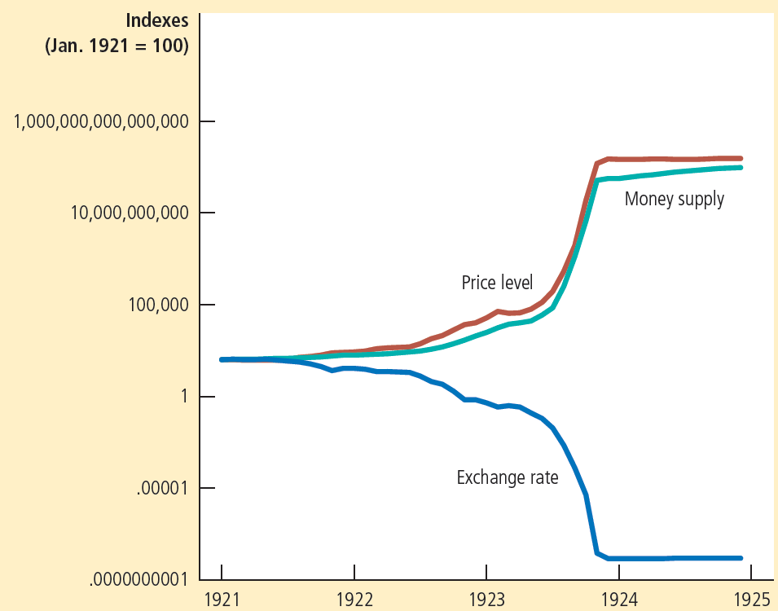
Figure 3
Money, Prices, and the Nominal Exchange Rate during the German Hyperinflation
This figure shows the money supply, the price level, and the exchange rate (measured as U.S. cents per mark) for the German hyperinflation from January 1921 to December 1924. Notice how similarly these three variables move. When the quantity of money started growing quickly, the price level followed, and the mark depreciated relative to the dollar. When the German central bank stabilized the money supply, the price level and exchange rate stabilized as well.
© 2015 Cengage Learning. All Rights Reserved. May not be copied, scanned, or duplicated, in whole or in part, except for use as permitted in a license distributed with a certain product or service or otherwise on a password-protected website for classroom use.

Slide 46
Limitations of PPP
Theory of purchasing-power parity does not always hold in practice
  Many goods are not easily traded
  Even tradable goods are not always perfect substitutes
    When they are produced in different countries
    No opportunity for profitable arbitrage
© 2015 Cengage Learning. All Rights Reserved. May not be copied, scanned, or duplicated, in whole or in part, except for use as permitted in a license distributed with a certain product or service or otherwise on a password-protected website for classroom use.

Slide 47
Limitations of PPP
Purchasing-power parity
  Not a perfect theory of exchange-rate determination
  Real exchange rates fluctuate over time
Large and persistent movements in nominal exchange rates
  Typically reflect changes in price levels at home and abroad
© 2015 Cengage Learning. All Rights Reserved. May not be copied, scanned, or duplicated, in whole or in part, except for use as permitted in a license distributed with a certain product or service or otherwise on a password-protected website for classroom use.

Slide 48

The hamburger standard
Data on a basket of goods consisting of
  “Two all-beef patties, special sauce, lettuce, cheese, pickles, onions, on a sesame seed bun”
    “Big Mac” - sold by McDonald’s around the world
You can find a Big Mac almost anywhere you look.
© 2015 Cengage Learning. All Rights Reserved. May not be copied, scanned, or duplicated, in whole or in part, except for use as permitted in a license distributed with a certain product or service or otherwise on a password-protected website for classroom use.

Slide 49
The hamburger standard
January 2013
  The price of a Big Mac was $4.37 in the United States
According to purchasing power parity
  Cost of “Big Mac” – same in both countries
  Predicted exchange rate = Price in foreign country (in foreign currency) divided by price in U.S.
© 2015 Cengage Learning. All Rights Reserved. May not be copied, scanned, or duplicated, in whole or in part, except for use as permitted in a license distributed with a certain product or service or otherwise on a password-protected website for classroom use.

Slide 50
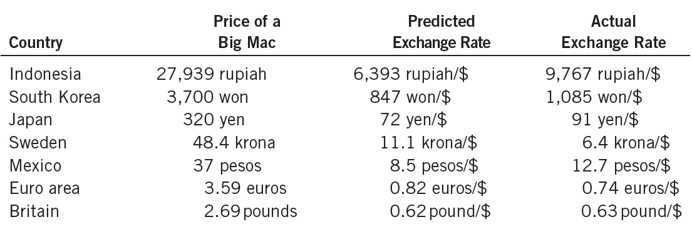
The hamburger standard
Predicted and actual exchange rates
  Are not exactly the same
  Reasonable first approximation
© 2015 Cengage Learning. All Rights Reserved. May not be copied, scanned, or duplicated, in whole or in part, except for use as permitted in a license distributed with a certain product or service or otherwise on a password-protected website for classroom use.

